Slide 1
CPD5 Active Learning and Digital Tools for Student Engagement
Aim: To activate some of the key areas of BSU Education Design Principles aiming at enhancing Effective Learning practices
Duration: 1 hour
Audience: Lecturers, Course Leaders
Placeholder EP

Slide 2
Learning Outcomes
To explore active learning and student-centred learning techniques.
To distinguish between active learning, authentic learning and assessment.
To apply digital tools for Engagement in Learning techniques.

Slide 3
Content
Activating Educational Design Principles
Active Learning
Authentic Assessment
Students Engagement with Digital Tools
Extra slide: Dethroning the Essay

Slide 4
Education Design Principles
CONNECTIVITY
CREATIVITY
INCLUSIVE TEACHING
Active Learning
COLLABORATIVE LEARNING
SUSTAINABILITY
DIGITAL FLUENCY
CURIOSITY DRIVEN PEDAGOGIES
Notes:
Active Learning connects the dots…. Bath Spa University: Education Design Principles
These principles provide a summary of our Education Strategy 2030 Objectives and outline the nature of our students’ educational experience and gains.
Summary & Contents
Connectivity: 1
Creativity: 2
Sustainability: 2
Digital Fluency: 2
Inclusive teaching: 2
Collaborative learning: 2
Curiosity-driven Pedagogies: 2
How can these Principles be used? 2
What does this mean for curriculum design? 3
Education Design Principles
A transformative learning journey with BSU enables:
Connectivity;
Creativity;
Sustainability and
Digital Fluency
Through inclusive, collaborative and curiosity-driven pedagogies.
Underpinning these principles is a commitment by the University to support staff in the development of their expertise for teaching in higher education.
Connectivity:
Students are connected with their future careers through developing their academic and employability skills, and their confidence;
Students are challenged at the forefront of their disciplines through the connection of curricula with research, professional practice and knowledge exchange activities.
Creativity:
Students are encouraged to explore, experiment, and reflect, including through cross-disciplinary activities, and through opportunities for active learning and authentic assessment.
Sustainability:
Students experience academic programmes that are regionally anchored and address global challenges, including environmental sustainability, through the UN Sustainable Development Goals.
Digital Fluency:
Students use and experience relevant and appropriate technologies, including through blended learning, and have opportunities to evaluate and develop their digital capabilities.
Inclusive teaching:
Our curriculum, learning resources and activities are diverse, inclusive and accessible, enabling a sense of belonging, opportunity and ambition.
Collaborative learning:
Our ways of working are enhanced through supportive learning communities. Staff and students engage in collaborative activities with peers and together through co-creation.
Curiosity-driven Pedagogies:
Our staff take an evidence-informed and scholarly approach to developing their curricula and teaching practices, and are supported in developing their expertise for teaching.
How can these Principles be used?
These principles can be used as an aide memoire of the Education Strategy for a variety of activities, for example designing and reviewing academic modules and programmes; planning or evaluating for student experience-related projects and initiatives.
What does this mean for curriculum design?
We take a thoughtful and evidence-informed approach to curriculum design at modular and programme level. At all stages we consider how the Education Design Principles are enacted:
Big Picture: we step back and consider the overall intention of our module or programme. How will it change our students’ ways of thinking about and viewing the subject and the world? What are the big ideas and concepts they will need to get? For modules, how does this connect with other modules to create a coherent programme picture?
Aims: having considered the bigger picture this can now be articulated as the educational aims of the module or programme. The aims are statements of the University’s intention for the module or programme, these might include: its purpose, the audience, and where it fits in the context of careers and/or further study. These aims will help students understand broadly what they should expect to gain from participating in the module or programme. Articulating these aims together as a teaching team (and with students through co-creation) helps to ensure a shared vision.
Learning Outcomes: the educational aims articulate what the module or programme intends to achieve. The intended learning outcomes articulate what the student will be able to do as a result of actively participating.
Assessment: assessment evaluates the extent to which the student has achieved the learning outcomes. If thoughtfully planned, it can also act as a vehicle to enable better learning. The type of assessment and learning activity/activities should be clearly aligned to the learning outcomes.
Learning Activities: learning activities are designed to provide a clear structure for students to enable them to navigate through the module and programme, and to develop the skills, knowledge and ways of thinking and practising required to meet the learning outcomes. This structure can be communicated and supported through the use of Ultra. This structured learning can be complemented by enhanced learning opportunities such as co-curricular support from Academic Skills (Ask), the Library, and Careers & Employability.
Resources: what resources do we need to ensure an effective learning experience? As well as teaching staff and materials, resources might include those from professional services such as the Library, Academic Skills (ASk), Careers & Employability, Student Wellbeing Services (SWS) etc; LinkedIn learning (and other e-learning tools); and specialist space (e.g. labs or studios), technologies and associated technical support.

Slide 5
What is Active Learning?
Active learning is the idea that students learn better when actively engaged in meaningful learning related to the topic of focus.
This approach tends to be more student focused, with the teacher facilitating activities.
Notes:
Definition from BSU website https://www.bathspa.ac.uk/projects/teaching-expertise-guide/creativity/

Slide 6
Related Terms to Active Learning
Authentic teaching/
learning
Real-world problems. Students' past or current experiences
Problem Based Learning (PBL)
Student focused
Exploring a topic
(preferably in groups)
Fieldwork or experiences
Authentic Assessment
Students’ experiences
Dethroning the essay!
Real / meaningful
Notes:
https://www.cardiff.ac.uk/__data/assets/pdf_file/0012/1164999/how_to_use_authenticteaching_experiences_in_your_teaching.pdf
Problem based learning: https://www.cumbria.ac.uk/research/enterprise/tean/teachers-and-educators-storehouse/archive/problem-based-learning/
Check this introduction to Authentic Learning or Assessment for learning https://sally-brown.net/2023/01/09/working-towards-more-authentic-assessment-a-pragmatic-approach-to-choosing-alternatives-that-are-right-for-you/

Slide 7
Make it yours (1)
How can you replace the “essays” with other alternatives?
Think podcasts, e-portfolios, pitches, videos, artefacts, poems, quilts, posters, games… the sky is the limit!
Notes:
Blue sky thinking. Everything goes here. Then choose the best options.

Slide 8
Authentic Assessment
A problem at home (e.g. project management to coordinate schedules)
A problem at work (e.g. an environmental management program for saving energy and reducing waste).
Notes:
The best assignments are those that can be applied at home or at work. Which ones you think you can use?

Slide 9
Students Engagement with Digital Tools
FLIP
POLL
COLLABORATE
SHARE
Notes:
Educational tools and technologies can be used to promote a more active teaching and learning style.

Slide 10
Flipped learning
Tools:
recorded video/audio uploaded to VLE or youtube
powerpoint voiceover presentation using pp recording functionality
smartphone recorder app
collated pre-made video content
other online resources ie. articles, sites
Further reading:
https://advance-he.ac.uk/knowledge-hub/flipped-learning-0
Notes:
Pre-recorded lecture content accessible to students before the taught session – they can then spend the live session seeking clarification, applying those concepts maybe by doing some enquiry or problem-based learning tasks, develop their higher order thinking skills by applying the learning.

Slide 11
Polling
Good for ice-breaker activities, well-being check-ins
A way to evaluate understanding of taught concepts (using MCQs)
Helps promote engagement
Can be more inclusive (gives a voice to those less confident in speaking up or with use of language)
Ask for feedback at end of session
Tools:
Many cloud-based polling apps available, all have free offerings but will have limitations to usage if not paid for:
Mentimeter | Vevox | Slido |PollEverywhere | WooClap | Socrative | Kahoot

Slide 12
Collaboration
Brainstorm activities with the cohort co-creating a wordcloud or post-it wall
Pose a question and collect ideas
Use a shared padlet or whiteboard for small group activities to present team ideas, online resources, solutions
Tools:
Some free apps available, will have limitations to usage if not paid for:
Padlet (post-it wall)
Miro (whiteboard)
LucidSpark (whiteboard)
Mural (whiteboard)
MS Whiteboard (all participants need MS account)

Slide 13
Sharing
Digital tools to allow sharing with the cohort either individually or in groups ie. feedbacking to the room, flipcharting
Q and As
Tools:
Some free apps available, will have limitations to usage if not paid for:
Padlet (post-it wall)
Miro (whiteboard)
LucidSpark (whiteboard)
Mural (whiteboard)
MS Whiteboard (all participants need MS account)
Shared word/powerpoint docs (if there is an institutional Microsoft 365 environment)

Slide 14
Make it yours (2)
Tool | Are you doing it already, how? Is this possible to do it?
Active Learning | Are the examples in the BSU materials relevant for your students and can you activate engagement?
Authentic Assessment | Are your assessments related with your students experience, how to make it relevant for them?
Digital tools for engagement | Going back to the profile of your students, what are the digital tools they use more?
Dethroning the essay | Examine the proportion of “essays” vs other forms of assessment. Can this change in line with the ILOs?
Notes:
These are really easy to use, but perhaps you have some you want to share with BSU?

Slide 15
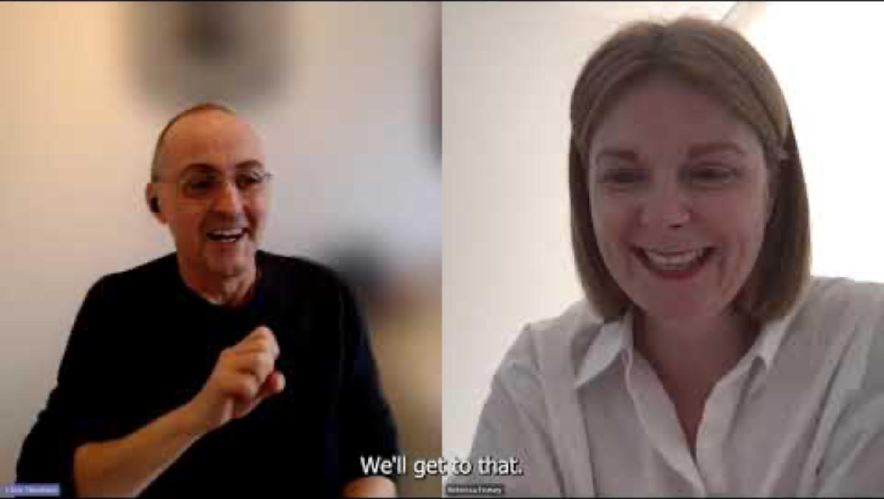
Extra slice: Dethroning the Essay
Guiding principles of assessment design
Student expectations of assessment
Adoption of digital tools
Assessing process as well as output
Future directions
Video Link here:
https://www.youtube.com/watch?v=T2GgOmgEp60
52 minutes if you have time!
Notes:
JISC video with BSU: https://www.youtube.com/watch?v=T2GgOmgEp60

Slide 16
Summary
4 Principles: Connectivity, Creativity, Sustainability and Digital Fluency
3 enablers: Inclusivity, Collaboration and Curiosity Driven pedagogies
Graduate Attributes are flexible
Knowing your students

Slide 17
Just One Thing
Tool | Easy to do
Flipped Learning | Pre-record a mini-video of 3 minutes ahead of your lecture. Ask your students to “comment” with an emoticon.
Polling | Open a free Kahoot or Mentimeter and make a quiz at the end of the lecture. It’s playful and fun..
Collaboration | Open a free Padlet and ask your students to post a picture that represent a concept or an idea.
Sharing | Open a Word document (MS 365 environment) and share it in Teams so the students can add their bit. It can be a “manifesto’ for the success of the lecture, etc.
17
Notes:
Try one of these activities, only one…

Slide 18
Resources
How to bring authentic teaching and assessment.
Getting to the heart of authentic assessment (article)
#Creative HE: Resources for creative teaching and learning
Problem Based Learning (guide)
18

